Slide 1
Personal Finance
Week 10

Slide 2
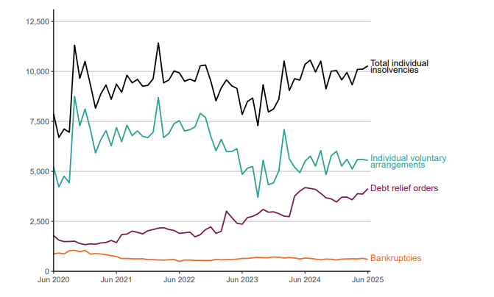
Monthly Individual insolvencies England & Wales
In June 2025, 10,279 individuals entered insolvency in England and Wales.
In the 12 months ending 30 June 2025, one in 415 adults in England and Wales entered insolvency (at a rate of 24.1 per 10,000 adults).
In 2024 the rate was 21.9 per 10,000
Source gov.uk

Slide 3
Personal Finance
Process of planning ones own spending, financing and investing to optimise your financial situation.
Understanding personal finance allows you to make informed decisions about your own financial situation
Financial Plan

Slide 4
Components of financial Planning
Set up Financial Objectives
Budgeting
Managing your debt
Protecting your assets and income
Investing your money
Planning your retirement
Monitor/Review

Slide 5
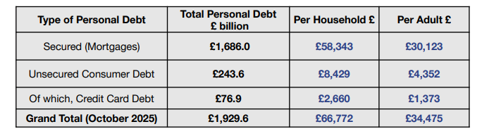
Managing Your Debt
People in the UK owed £1,929.6bn at the end of October 2025
Average debt per household was £66,772, per adult was £34,475- around 90.2% of their average earnings…
Common forms of personal borrowing
Bank overdrafts
Student loans
Mortgages (4/5 of debt)
Credit card
Source: Money statistics
Notes:
The money charity

Slide 6
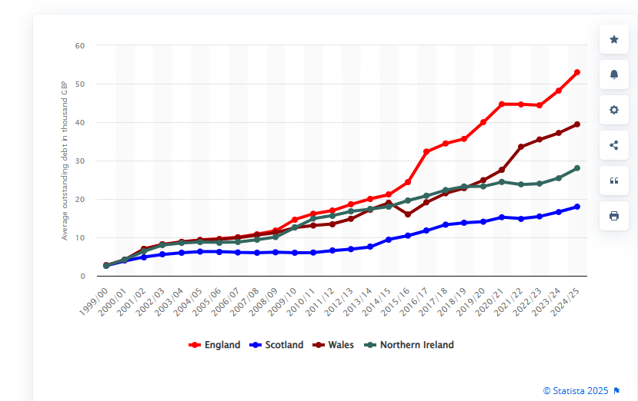
In 2025, students graduating from English universities have an average of £53,000 student loan debt; £39,000 in Wales: 28,000 in Northern Ireland; £18,000 in Scotland

Slide 7
Student Loans 25/26 new rules introduced Sep 2023- old in brackets
Maximum Loan
Fees £9250/year (£9535 next year)
Maintenance- variable amount (up to £13,762 London)
Interest on Student Loan- RPI
During the course and up to April after graduation RPI (RPI+3%)
From April if earning less than £25,000 (£27.295k) RPI
From April if earning between £25,000 and £49.13K RPI (RPI+ 0-3%)
From April if earning more than £49.13K RPI (RPI+3%)
Loan Repayments
9% of earnings over the threshold
Debt is written off after 40 years (30 years before)

Slide 8
Student Loans
+£53,000 at the end of a 3 year degree
Likely to be paid over a long time…
Can be paid earlier at no penalty
Loans are collected directly via the PAYE (Pay As You Earn) scheme
Once a year a statement is sent
The Government forecasts that around 56% of full-time undergraduates starting in 2024/25 would repay them in full. This is more than double the forecast for the 2022/23 cohort (32%) because of reforms to student loan repayments for new students.
Source: Commons library research briefing December 2025

Slide 9
What changed
The UK government introduced new rules in September 2023 that extended the repayment window from 30 years to 40 years, cut the minimum salary for repayments from £27,295 to £25,000, and cut interest rates
Some argue the changes will disproportionally affect women (men tend to be higher earners and have less career breaks- thus have higher average income)
A good read “Who will bear the brunt of England Student loan reform?” Financial Times (12th Feb 2024)

Slide 10
Example
A student graduating with £42,000 debt in student loans, takes a job, after graduation, that pays £30,000/year. His starting salary will increase by 5% p.a. through his working life and the loan attracts a rate of 3% (RPI). What is the value of the debt 15 years after graduation? 26 years after graduation? The threshold is £25,000 and payments are annual

Slide 11
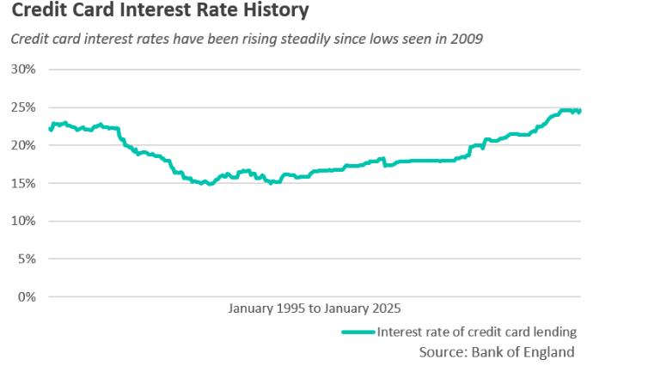
Credit Cards
Can be used to pay goods and services instead of using cash or a debit card
Can give more than 30 days of credit
Balance that is not offset carries very high interest rates! (7-20%)
Other charges
Annual fees
Withdraws lead to interest

Slide 12
From where can you get debt
Bank
Building societies
Peer to peer lending
Finance Houses
Pay day loans
£100-£1000
1000%-1500%

Slide 13
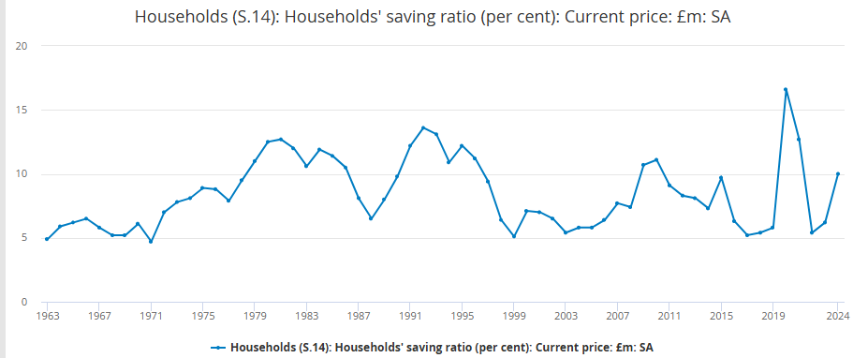
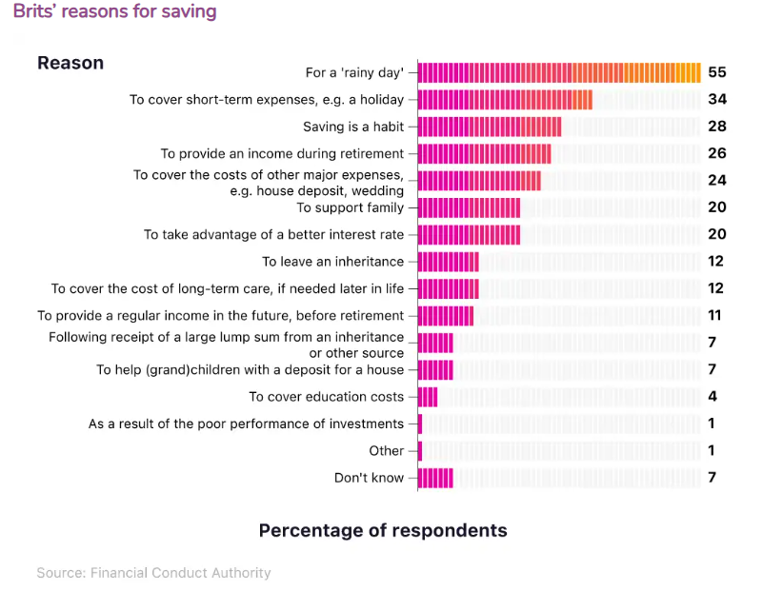
Building your savings
Saving means giving up current income
Helps to provide security later
UK adults have an average of £16,067 in cash savings. 39% have £1,000 or less and 16% no savings! (Survey by Finder UK 2025)
Reasons for saving
Transactions motive
Precautionary motive
Speculative motive
Notes:
Saving/disposable

Slide 14
Main types of savings accounts
Instant access accounts
Access without penalty
Regular Savings Accounts
Encourages saving habits
Fixed rate and Fixed Term Accounts
Better rates but penalty on withdrawals before term

Slide 15
Where to Save?
Banks or Building Societies
National Savings and Investments
Government savings bank (guarantee all the savings not only the 85K of the Financial Services Compensation Scheme
ISAs; Green Bonds; Premium bonds…
Credit Unions
Like a cooperative in which generally members have something in common (church; trade union)
Peer-peer Lending
Generally higher return- much greater risk… (not generally covered by FSCS)

Slide 16
Tax & Savings and ISA
UK tax payers have to pay tax on the income of their savings/investments
Individual savings accounts do not pay tax (interest or capital gains)-You have be resident in the UK
There are 5 types of ISAs:
Cash
Stocks & Shares
Lifetime
Innovative (peer to peer or crowdfunding)
Junior
Notes:
Junior- 9000 and up to 16

Slide 17
ISAs
Wrapper
You can open most ISAs from aged 18- the exception is Junior ISA
The amount savers can put into an ISA is £20,000/per year (frozen until 2031) (£4000 for lifetime; 9000 for junior)
From April 2025 there is a cash ISA Cap for under 65 of £12,000

Slide 18
Lifetime ISAS
Adult under 40 are be able to open a Lifetime ISA.
Up to £4,000 can be saved each year and savers receive a 25% bonus from the government on this money.
Money put into this account can be saved until you are over 60 and used as retirement income, or you to help buy your first home (if you already have a home you cannot use the LISA to buy another).
CAP on the house £450,000
If you are using it towards your pension you can only withdraw the money after 60

Slide 19
Example of tax efficient investment Investment ISA
Suppose that you will invest for 10 years (at the end of each year) your maximum allowance in an investment ISA. How much will you have saved at the end of the 10 years assuming that your investment has an average annual return before tax of 4%. Assume the allowance will be set at the current values for the next 10 years.

Slide 20
Investing for longer term
Usually means investing in assets or funds which can be based in the stock market.
Long term investors may:
Invest directly into an asset class
Shares
Bonds
Invest in pooled investments (Funds and ETFs)

Slide 21
Plan for Investing, and Retirement
Any funds you have beyond what you need for liquidity should be saved and invested.
Retirement planning involves determining how much money will you set aside each year for retirement and how you should invest that money.
Retirement planning has to start well before retirement- this money is protected from taxes.
Notes:
£221 week- option 2012

Slide 22
Plan for Investing, and Retirement
Suppose that you intend to retire in 30 years and that you want to have £500,000 in the bank so that you can live comfortably once you retire. If the bank pays you a monthly interest rate of 0.085% how much money should you put in the bank every month for the next 30 years?

Slide 23
Example- after 26 years
A student graduating with £42,000 owing in student loans, takes a job on graduation that pays £30,000/year. His starting salary will increase by 5% p.a. through his working life and the loan attracts a rate of 3% (RPI). What is the value of the debt 26 years after graduation? The threshold is £25,000

Slide 24
Example in Slide 10 with old rules
A student graduating with £42,000 owing in student loans, takes a job on graduation that pays £30,000/year. His starting salary will increase by 5% p.a. through his working life and the loan attracts a rate of 3% (RPI+). What is the value of the debt 15 years after graduation? 26 years after graduation? The threshold is £27.295

